Slide 1
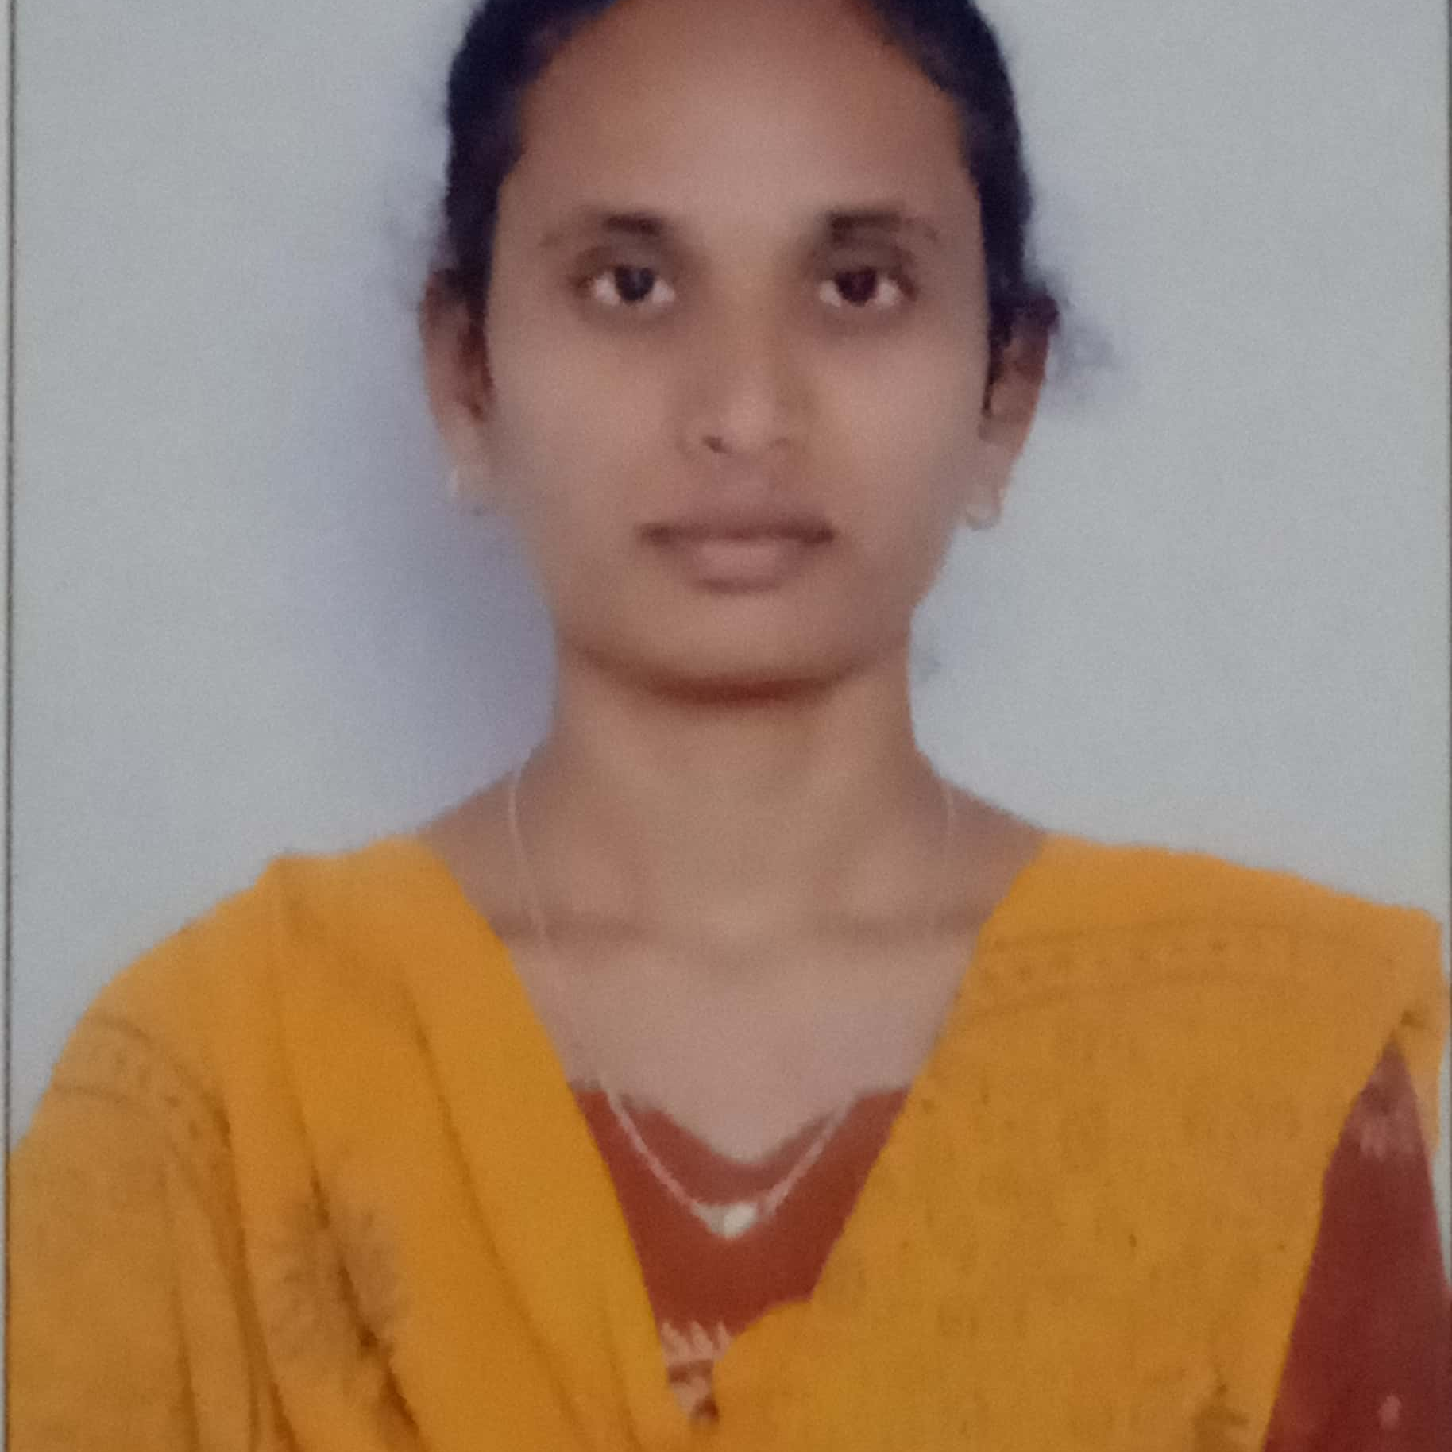



RAJITHA KUMMARA
Bachelor of Engineering
Electronics & Communication :
2018-2021
Analyst/Software Engineer
Skills
Java 8 /J2EE | Java Basics, OOPS, Generics, Collections, Arrays, Loops, Lambda Exp, Stream API Junit, Mockito, Servlets
Spring core | IOC & Dependency Injection, Auto wire
Spring REST | REST controllers, Implementation of GET, POST, PUT & DELETE, Bean Validation & Exception Handling, Testing Services, Controller & Repository layer
Spring Data JPA | Implement DAO layer using spring Data repositories, Transaction Management
Spring Boot Microservices | Spring Boot Starters, annotations, Messaging Service, Sync/Async comms, Swagger API documents
Spring Cloud | Eureka, Netflix Ribbon, Feign Client, Netflix Hystrix, Netflix Zuul & Config Server
Angular | Components, Services, Modules, Routing, Forms & Validation.
Database | MongoDB, My SQL RDS Basics
UI Tech | HTML 5 & CSS 3,JavaScript, ES6 & TypeScript Reusable templates, Optimized UI Designed
Tools | Git, Postman, Maven, IDE
Add On skills | Communications, Team management. Peer learning
Bangalore
rajitha.kummara@capgemini.com
9121711066
A4
Full Stack Developer
Hands on experience in creating microservices with Spring boot, Spring Security, Spring Cloud API Gateway, Eureka server.
Proficient in creating Single page Web Application in Angular with Authentication with route guards, Angular reactive forms, angular routing.
Experience in creating documentation with Java docs and swagger and in unit testing using Junit, Mockito.
In-depth understanding of deploying spring boot applications in AWS Cloud environment
Online Railway Reservation System
Completed end to end case study of Online Railway Reservation Application along with JWT authentication, Swagger and responsive UI with CSS and Angular used for user interface.
Tools :
Backend: Core Java, Spring Boot, JPA, Hibernate, PostgreSQL, Swagger, Spring Security.
Frontend: HTML, CSS, Bootstrap, Angular
Completed ”AWS CCP CERTIFICATION”
Check out my work on GitHub & Video Profile

